Slide 1



Trusted sla-guided data integration on multi-cloud environments
Daniel Aguiar da Silva Carvalho, Magellan, IAE, Université Jean Moulin Lyon3
Advisors
Chirine Ghedira Guegan, LIRIS, UMR5205, IAE, Université Jean Moulin Lyon3, France
Genoveva Vargas-Solar, CNRS, LIG-LAFMIA, France
Nadia Bennani, LIRIS, UMR5205, INSA-Lyon, - France
Notes:
Good morning, my name is Daniel Aguiar and today I will present my thesis work entitled « Trusted SLA-Guided Data Integration on Multi-Cloud Environment » supervised by Chirine Ghedira-Guegan, Genoveva Vargas-Solar and Nadia Bennani.

Slide 2
Daniel Aguiar da Silva Carvalho
Current position
2014-2017
3rd year of PhD
InfoMaths doctoral school, University Lyon 1, Magellan Lab, Lyon3
Projects & Internships
Project Multi-cloud, ARC-6
Education
2013
Master in Systems and Computing
Federal University of Rio Grande do Norte, Brazil
Projects & Internships
4-months Internship
UDELAR, Uruguay (CAPES)
National Research Network, Brazil
2011
XXX degree System analysis
Federal Institute of Rio Grande do Norte, Brazil
Notes:
Briefly presenting myself,
Currently, I am in the third year of PhD attached to the doctoral school InfoMaths at Lyon1 and working in the Magellan research center at Lyon3. My thesis is funded by the ARC 6 project.
In 2013, I concluded my master in systems and computing at the federal university of rio grande do norte, Brazil. During this time I had a CAPES scholarship and I made a 4-months interniship at UDELAR, Uruguay. Furthermore, I have worked to in a project funded by the National Research Network in Brazil.
In 2011, I graduted in systems analysis in Federal Institute of Rio Grande do Norte, Brazil.

Slide 3
Research context: data integration
Query
Result
Data integration: the teenage years. Halevy, A., Rajaraman, A., & Ordille, J. (VLDB 2006, September)
Schema integration: Past, present, and future (Ram, S., & Ramesh, V. 1999)
Global schema
Mediator
Query rewriting
Data integration architectures:
Multi-databases, federations, DW, …
(Domenig & Dittrich 1999 Sigmod Record)
MiniCon algorithm for query rewriting (Pottinger and Halevy, 2001)
Exported schemata
Data
source A
Data
source B
Data
source C
Heterogeneous data sources known in advance
Notes:
The research context of this thesis is data integration. The very classic vision of data integration is defined as follows: Given a set of heterogeneous data sources known in advance, provide solutions for retrieving data and answering queries.
This problem is well known in the database domain. Several works have been proposed concerning, for example, data models equivalence and transformation, schema matching and integration, and query rewriting algorithm such as MiniCon.

Slide 4
Research context: data integration
Services lookup and matching
[1] Paolucci, M., Kawamura, T., Payne, T. R., & Sycara, K. (2002, June). Semantic matching of web services capabilities. In International Semantic Web Conference (pp. 333-347). Springer Berlin Heidelberg.
[2} Bramantoro, A., Krishnaswamy, S., & Indrawan, M. (2005, November). A semantic distance measure for matching web services. In International Conference on Web Information Systems Engineering (pp. 217-226). Springer Berlin Heidelberg.
[3} APA Maximilien, E. M., & Singh, M. P. (2004, November). Toward autonomic web services trust and selection. In Proceedings of the 2nd international conference on Service oriented computing (pp. 212-221). ACM.
Query
Result
Mediator
Query rewriting techniques adapted to service composition
Exported API
[4] Barhamgi, M., Benslimane, D., and Medjahed, B. (2010). A query rewriting approach for web service composition. IEEE T. Services Computing, 3(3):206–222.
[5] da Costa, U. S., Alves, M. H. F., Musicante, M. A., and Robert, S. (2013). Automatic refinement of service compositions. In Daniel, F., Dolog, P., and Li, Q., editors, ICWE, volume 7977 of Lecture Notes in Computer Science, pages 400–407. Springer.
[6] Zhao, W., Liu, C., and Chen, J. (2011). Automatic composition of information-providing web services based on query rewriting. Science China Information Sciences, pages 1–17.
. . .
Distributed data services
Notes:
The emergence of data services changed the data integration problem. Particularly, the hypothesis that assumed that data sources were known in advance.
The data integration problem in the presence of services as data providers redefined the problem as follows: Given a query expressing data requirements, look up data services that can fulfill those requirements. The assumptions were that services exported their API and that they can export data under a pivot model that can be used for integrating results.
Thus, the query rewriting problem was redefined as a matching and a service composition problem and has led to fruitful results on query rewriting and service matching.

Slide 5
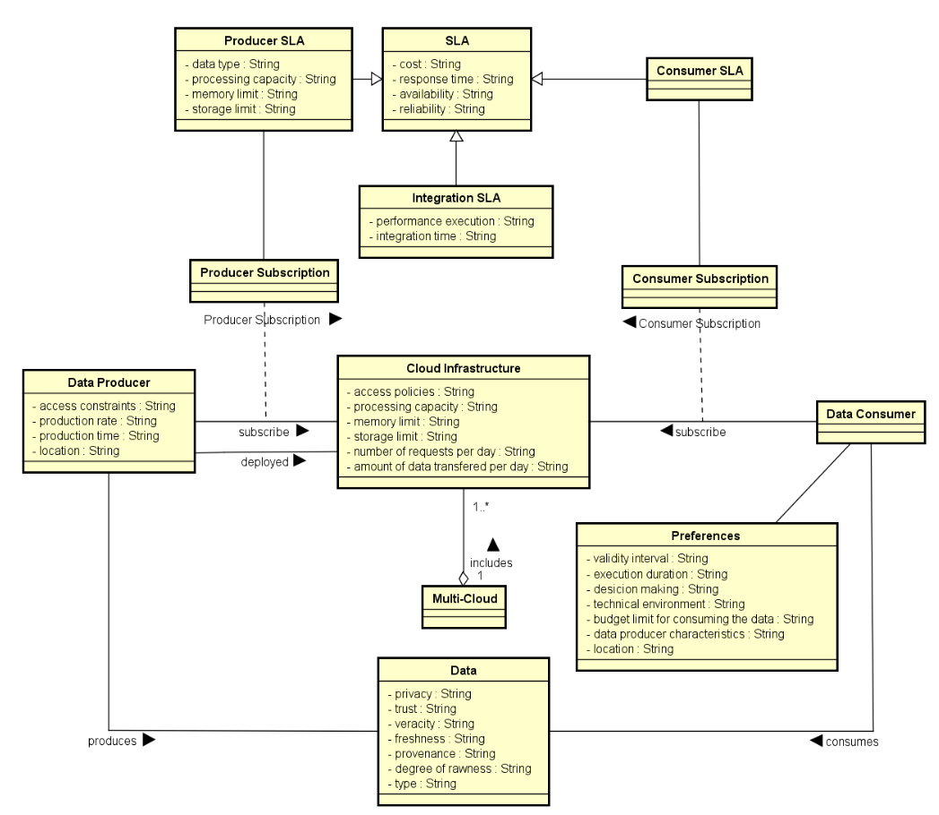
¹ D. A. S. Carvalho, P. A. S. Neto, C. Ghedira, G. Vargas-Solar, N. Bennani. Towards Quality Guided Data Integration on Multi-Cloud Settings. 14th international conference on service oriented computing (ICSOC), Oct 2016, Banff, Alberta, Canada.

Slide 6



Research context: limitations
Mainly associated to performance (availability and response time) and privacy.
Query with requirements
Mediador
The service selection and composition are not done considering SLAs and data properties.
Results
Data providers are not allowed to express properties of the data they are delivering.
Current solutions do not consider that data providers can be out of resources according to their cloud subscriptions.
S1
S7
S2
S5
S6
S8
S9
S1
S3
S4
Data Provider A
Data Provider C
Data Provider B
Data Provider C
Data Provider A
Data Provider D
SLA
SLA
SLA
SLA
SLA
SLA
Cloud Provider 1
Cloud Provider 2
Cloud Provider 3
Current SLAs are insterested only in performance aspects and business rules.
24/03/2017
6

Slide 7



Data integration from data services
SLA
SLA
Availabity > 99,9%
Price per call = 0,5$
SLA
Data provider A: infected patient
Data provider C: Personal information
Availabity > 97%
Price per call = 0,1$
Availabity > 98%
Price per call = 0,3$
Data provider B: DNA information
Notes:
Consider the following example consisting of services that provide biological data to Health professionals
… data provider A provides information about infected patients
… data provider B provides DNA information
… data provider C provides personal information
Besides each provider exports its own Service Level Agreement specifying what a consumer can expect from its service…
In this example SLA’s define the availability and the price per call for each service. Thus data provider A is available 97% of the time and the price per call costs 0,15
Whereas data provider C is 99,9% of the time available and the price per call is 0,5 cents

Slide 8

Data integration from data services
SLA
Consumer
SLA
Availabity > 99,9%
Price per call = 0,5$
Retrieve personal and DNA information from patients that were infected by flu, using services with availability higher than 98%, price per call less than 0.2$ & total cost less than 5$
SLA
Data provider A: infected patient
Data provider C: Personal information
Availabity > 97%
Price per call = 0,1$
Availabity > 98%
Price per call = 0,3$
Data provider B: DNA information
Notes:
A data consumer could define her data requirements with associated restrictions as follows
Retrieve personal and DNA information from patients that were infected by flu, using services
with availability higher than 98%, price per call less than 0.2$ & total cost less than 5$
In order to express the query the consumer has an abstract view of services and this abstract view has associated a list of possible
Concrete services definitions that the consumer does not need to know. Particularly because there can be a lot and it could be painful to manually choose them

Slide 9
Abstract service & quality measures
SLA
Consumer
SLA
S1 (a?; b!) := A1 (a?; b!) [availability > 98%, price per call = 0,2$]
S2 (a?; b!) := A1 (a?; b!) [availability > 98%, price per call = 0,1$]
S3 (a?; b!) := A2 (a?; b!) [availability > 99%, price per call = 0,1$]
S4 (a?; b!) := A1 (a?; p!), A2 (p?; b!) [availability > 98%, price per call = 0,1$]
S5 (a?; b!) := A3 (a?; b!) [availability > 98%, price per call = 0,0$]
S6 (a?; b!, c!) := A1 (a?; p!), A2 (p?; b!), A3 (p?; c!) [availability > 99%, price per call = 0,2$]
S7 (a?; b!) := A4 (a?; b!) [availability > 99%, price per call = 0,2$]
SLA
Data provider A: infected patient
Data provider C: Personal information
Data provider B: DNA information
Notes:
We use the following declarative expressions for formally describing this abstract – concrete services association
In our example, given these 7 concrete services, the abstract service A1 returns infected patients given a disease, A2 returns the DNA information and A3 the patient personal information… between brackets we can also see the quality features associated to each concrete service
A4??

Slide 10
Query with associated preferences
SLA
SLA
Retrieve personal and DNA information from patients that were infected by flu, using services with availability higher than 98%, price per call less than 0.2$ & total cost less than 5$
Q(dis?; dna!, info!) :=
A1 (dis?; p!), A2 (p?; dna!), A3 (p?; info!),
dis= “flu” , [availability > 99%, price per call < 0,2$, total cost < 5$]
Data provider A: infected patient
Data provider C: Personal information
S1 (a?; b!) := A1 (a?; b!) [availability > 98%, price per call = 0,2$]
S2 (a?; b!) := A1 (a?; b!) [availability > 98%, price per call = 0,1$]
SLA
S5 (a?; b!) := A3 (a?; b!) [availability > 98%, price per call = 0,0$]
S6 (a?; b!, c!) := A1 (a?; p!), A2 (p?; b!), A3 (p?; c!) [availability > 99%, price per call = 0,2$]
S7 (a?; b!) := A4 (a?; b!) [availability > 99%, price per call = 0,2$]
Data provider B: DNA information
S3 (a?; b!) := A2 (a?; b!) [availability > 99%, price per call = 0,1$]
S4 (a?; b!) := A1 (a?; p!), A2 (p?; b!) [availability > 98%, price per call = 0,1$]
Notes:
Similarly, the query can be also expressed in terms of abstract services and it user preferences can be associated to them
For instance, our previous query example can be expressed in the following datalog like manner:
The left-side is called the head and the right-side is the body. In the head definition, there are a set of comma-separated input variables (identified by the question mark) and output variables (identified by exclamation mark). These variables are called head variables and they can be used by any abstract service in the body definition. In the body definition, the query is expressed as a sequence of abstract services, a set of constraints and user preferences. Abstract services (such as A1, A2 and A3) also have input and output variables. Variables that appear only in abstract services are called local variables (such as ‘p’). ‘Dis’ is a constraint used while executing the query. Between brackets are the user preferences.

Slide 11
Combining services for answering queries
Q(dis?; dna!, info!) := A1 (dis?; p!), A2 (p?; dna!), A3 (p?; info!), d= “flu , [ availability > 99%, price per call < 0,2$, total cost < 5$]
S1, S3, S5
S2, S3, S5
S4, S5
S6
Data provider A: infected patient
Data provider C: Personal information
S1 (a?; b!) := A1 (a?; b!) [availability > 98%, price per call = 0,2$]
S2 (a?; b!) := A1 (a?; b!) [availability > 98%, price per call = 0,1$]
S5 (a?; b!) := A3 (a?; b!) [availability > 98%, price per call = 0,0$]
S6 (a?; b!, c!) := A1 (a?; p!), A2 (p?; b!), A3 (p?; c!) [availability > 99%, price per call = 0,2$]
S7 (a?; b!) := A4 (a?; b!) [availability > 99%, price per call = 0,2$]
Data provider B: DNA information
S3 (a?; b!) := A2 (a?; b!) [availability > 99%, price per call = 0,1$]
S4 (a?; b!) := A1 (a?; p!), A2 (p?; b!) [availability > 98%, price per call = 0,1$]
Notes:
Given the query, the different concrete services can be combined in order to produce results. Such as composing:
...S1 (which retrieves infected patients), S3 (which retrieves DNA) and S5 (which retrieves personal information)
...S2 (which retrieves infected patients), S3 (which retrieves DNA) and S5 (which retrieves personal information)
...S4 (which retrieves infected patients and DNA) and S5 (which retrieves personal information) or
...S6 (which returns all desired data)
Here, it is interesting to highlight that a filtering process is necessary to guarantee that the user preferences and requirements are satisfied.

Slide 12
Vision: Data integration
A combinatorial problem where a query result is a data collection integrated by
composing different data providers
data processing (cloud) services
that fulfill quality constraints and SLAs specified by a data consumer
Notes:
Considering this context, in our vision, data integration deals with a combinatorial problem where a query result is a data collection integrated by composing different data providers and data processing (cloud) services that fulfill quality constraints and SLAs specified by a data consumer.

Slide 13
Objective
Guide the integration process explicitly considering
data providers quality &
infrastructure properties
(reliability, computing, storage & memory capacity, cost)
Notes:
In consequence, our objective is to guide the integration process explicitly considering data providers quality and infrastructure properties such as reliability, computing, storage and memory capacity, and cost.

Slide 14
Approach: data integration workflow
Reusing previous
results
Search for previous queries
With respect to our query taxonomy and reusability approach
Storing results
- With respect to quality requirements
- According to our query taxonomy
Processing the complete rewriting
Storing results in our query history
Service-based query rewriting according to SLA
Notes:
To achieve our objectives we have proposed a data integration approach which concerns the following workflow:
First, we search for previous queries in our history. The queries are matched with respect to the quality requirements and similar queries are identified in accordance with our query taxonomy.
Then, if a match is found, we can reuse the results (data services and compositions) according to the type of query and the reusable aspects associated to this type.
If no match is found, the entire rewriting process is done according to the user requirements and SLAs.
And, finally, the results for this new query is stored to possibly be reused in a next query.

Slide 15
Results and contribution
Data Integration Metamodel
Building the corpus of State of the Art using the systematic mapping methodology¹
Describing the challenges and problems of SLA guided data integration
Rhone Query
Rewriting Algorithm
Rewriting approach taking into consideration user requirements and Service Level Agreements
Query Taxonomy
Indentification and formalization of queries to be treated by our approach
Query Rewriting Reuse Strategies
Formalization of a reusability approach for reducing the query rewriting overhead
¹ D. A. S. Carvalho, P. A. Souza Neto, G. Vargas-Solar, N. Bennani, C. Ghedira, Can Data Integration Quality be Enhanced on Multi-cloud using SLA?, In 26th Int. Conf. on Database and Expert Systems Applications, Spain, 2015.
Notes:
The results and contribution achieved while developing our approach are sumarized following:
First, we have designed a data integration metamodel adapted to the multi-cloud context. This model describes the challenges and problems associated to the SLA guided data integration, and it was done based on our corpus of state of the art that was built using a systematic mapping methodology. As result this methodology work, we had a paper published in DEXA 2015.
We have designed and implemented a query rewriting algorithm which takes into consideration user requirements and SLAs called Rhone.
A set of queries that can be treated by our approach were formalized,
and based on them we have formalized a reusability approach for reducing the overhead of query rewriting process

Slide 16
Rhone Service-Based Query Rhone: Rewriting Algorithm
Selecting candidate concrete services
Creating candidate service descriptions (CSD)
Combinig CSDs
Producing rewritings
A rewriting algorithm customizing
data providers (services) look up
data integration considering different data consumers requirements and expectations
requirements & expectations depend on the context in which they consume data (e.g., mobile devices with few physical capacities, critical decision making)
¹ D. A. S. Carvalho, P. A. S. Neto, C. Ghedira, G. Vargas-Solar, N. Bennani. Rhone: a quality-based query rewriting algorithm for data integration. East-European Conference on Advances in Databases and Information Systems, Aug 2016, Prague, France. ADBIS East-European Conference on Advances in Databases and Information Systems, 2016.
Notes:
We have proposed and designed a service-based query rewriting algorithm taking into account our approach and hypotesis.
It consists in 4 steps: including service matching and service combination ensuring that they fulfill quality requirements.
Our algorithm customizes:
The data providers services look up. The data integration considering different data consumers requirements and expectations
And the requirements and expectations depend on the context in which they consume data (e.g., mobile devices with few physical capacities, critical decision making)
In the following I briefly describe the general principle of the steps.

Slide 17
Concrete service matching
S1 (a?; b!) := A1 (a?; b!) [availability > 98%, price per call = 0,2$]
A query with preferences
A set of concrete services &
Choose those services that match data required with data produced
S2 (a?; b!) := A1 (a?; b!) [availability > 98%, price per call = 0,1$]
S3 (a?; b!) := A2 (a?; b!) [availability > 99%, price per call = 0,1$]
S4 (a?; b!) := A1 (a?; p!), A2 (p?; b!) [availability > 98%, price per call = 0,1$]
S5 (a?; b!) := A3 (a?; b!) [availability > 98%, price per call = 0,0$]
S6 (a?; b!, c!) := A1 (a?; p!), A2 (p?; b!), A3 (p?; c!) [availability > 99%, price per call = 0,2$]
S7 (a?; b!) := A4 (a?; b!) [availability > 99%, price per call = 0,2$]
Q(dis?; dna!, info!) :=
A1 (dis?; p!), A2 (p?; dna!), A3 (p?; info!),
d= “flu”, [ availability > 98%, price per call < 0,2$, total cost < 5$]
Notes:
While selecting candidate concrete services we deal with a concrete service matching.
For instance, in this step considering a query with preferences and a set of concrete services.
We have to choose those services that match data required with data produced.
Click
As you can see we select services that can produce a result for the user query.
And, consequently, the service S7 is discarded once it can not produce a result to the query.
Click

Slide 18
Matching quality features
A query with preferences
A set of concrete services that match data required with data produced
Choose services that match preferences
S1 (a?; b!) := A1 (a?; b!) [availability > 98%, price per call = 0,2$]
S2 (a?; b!) := A1 (a?; b!) [availability > 98%, price per call = 0,1$]
S3 (a?; b!) := A2 (a?; b!) [availability > 99%, price per call = 0,1$]
S4 (a?; b!) := A1 (a?; p!), A2 (p?; b!) [availability > 98%, price per call = 0,1$]
S5 (a?; b!) := A3 (a?; b!) [availability > 98%, price per call = 0,0$]
S6 (a?; b!, c!) := A1 (a?; p!), A2 (p?; b!), A3 (p?; c!) [availability > 99%, price per call = 0,2$]
S7 (a?; b!) := A4 (a?; b!) [availability > 99%, price per call = 0,2$]
Q(dis?; dna!, info!) :=
A1 (dis?; p!), A2 (p?; dna!), A3 (p?; info!),
d= “flu”, [ availability > 98%, price per call < 0,2$, total cost < 5$]
Notes:
we also deal with a matching of quality features according to the user preferences and requirements
In our example the quality feature “Price per call” guaranteed by the services S1 and S6 do not cover the user requirement. Thus, they are discarded.
Once this process is finished we have a final list of candidate concrete services.

Slide 19
Matching & combining concrete services
CSD₂
Combinations
S2 (a?; b!) := A1 (a?; b!) [availability > 98%, price per call = 0,1$]
p₁ = { CSD₂ }
p₂ = { CSD₂ , CSD₃ }
p₃ = { CSD₂ , CSD₃ , CSD₅ }
CSD₃
S3 (a?; b!) := A2 (a?; b!) [availability > 99%, price per call = 0,1$]
S4 (a?; b!) := A1 (a?; p!), A2 (p?; b!) [availability > 98%, price per call = 0,1$]
CSD₅
S5 (a?; b!) := A3 (a?; b!) [availability > 98%, price per call = 0,0$]
Q(dis?; dna!, info!) :=
A1 (dis?; p!), A2 (p?; dna!), A3 (p?; info!),
dis= “flu”, [ availability > 98%,
price per call < 0,2$,
total cost < 5$]
19
Notes:
Considering our candidate concrete services, CSDs for S2, S3 and S5 are created.
A CSD for S4 cannot be created once the variables mapping is not possible.
Click
Given these 3 CSDs the combinations are produced taking into account the part of the query that it covers. In this case, 3 combiantions are generated.

Slide 20
Validating combinations
CSD₂
Combinations
S2 (a?; b!) := A1 (a?; b!) [availability > 98%, price per call = 0,1$]
p₁ = { CSD₂ }
p₂ = { CSD₂ , CSD₃ }
p₃ = { CSD₂ , CSD₃ , CSD₅ }
CSD₃
S3 (a?; b!) := A2 (a?; b!) [availability > 99%, price per call = 0,1$]
S4 (a?; b!) := A1 (a?; p!), A2 (p?; b!) [availability > 98%, price per call = 0,1$]
CSD₅
S5 (a?; b!) := A3 (a?; b!) [availability > 98%, price per call = 0,0$]
Q(dis?; dna!, info!) :=
A1 (dis?; p!), A2 (p?; dna!), A3 (p?; info!),
dis= “flu”, [ availability > 98%,
price per call < 0,2$,
total cost < 5$]
20
Notes:
Looking to the combination produced. We have to verify if they cover the entire query and exactly what the user expects.
Click
In this sense, only p3 is a valid rewrite of the query. Why?

Slide 21
Reusing queries
Q₁(dis?; dna!, info!) := A₁ (dis?; p!), A₂ (p?; dna!), A₃ (p?; info!),
[availability > 99%, price per call < 0,2$, total cost < 5$]
stored
Q₁ := < s, t, A, R, C, w >
Supposing that Q₂ is a subset of Q₁:
Q₃ := < s, t, A, R, C, w >
This means Q₂.A ⊂ Q₁.A and Q₂.R ⊲ Q₁.R
Q₄ := < s, t, A, R, C, w >
Q₂ := < s?, t?, A, R, C?, w? >
Q₅ := < s, t, A, R, C, w >
reuse results
Q₂.C ⟵ {c_{i}} st. {⩝c_{i} ∊ Q₁.C, ∄ds ∊ c_{i} | ds is offline}
Q₆ := < s, t, A, R, C, w >
Q₂.C ⟵ project(Q₂)
Q₇ := < s, t, A, R, C, w >
Q₂.S ⟵ {ds_{i}} st. {⩝ds_{i} ∊ Q₁.S, ∃c ∊ Q₂.C | ds_{i} ∊ c}
Q₈ := < s, t, A, R, C, w >
Q₂ := < s, t, A, R, C, w >
Q₂.w ⟵ max (Q₂.C)
Q₉ := < s, t, A, R, C, w >
...
stored
Query History
Rhone was adapted to be in accordance history.

Slide 22
Experimental validation
The Rhone first version is implemented in Java
Evaluate the algorithm’s behavior
performance, quality and cost
Local environment simulating a mono-cloud
including a registry of 100 services
Two approaches compared
Traditional (without considering preferences and SLA) versus
Preference-guided (i.e., Rhone)
Notes:
We have performed experiments in order to validate our algorithm.
The first version is implemented in Java.
The idea behind the experiments is to evaluate the algorithm’s behavior.
To do so, the experiments were executed in a local environment including a service registry of 100 concrete services.
And we have compared two approaches: a traditional (without considering preferences and SLA) versus a preference-guided.

Slide 23
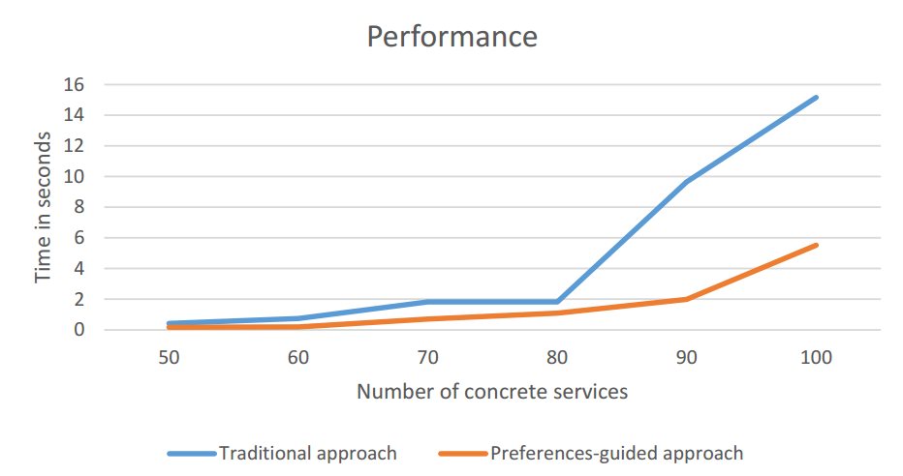
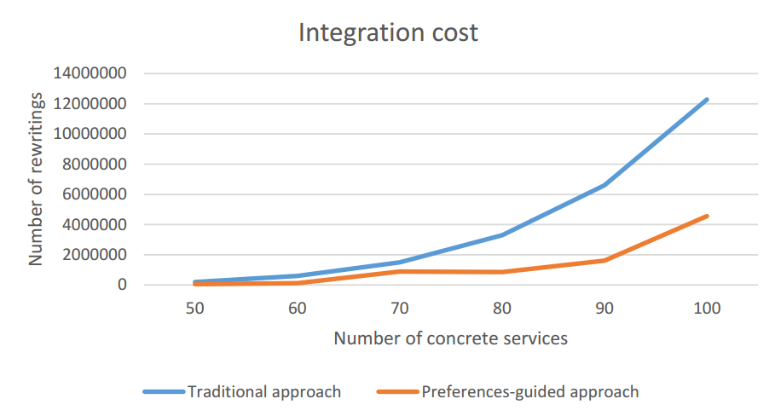
Implementation & experiments
Cloud simulation including 100 services
Expensive while combining services: O(n^{k})
Performance increased reducing the number of rewriting solutions and integration execution time
Integration economic cost potentially reduced
Notes:
Based on the experimental validation, we can show you the Rhones’ profile
We can see the complexity of the different phases. As in the other algorithms, the most expensive step is the combination. It depends on the size of the query and the number of concrete service that could be mapped to the query.
The results of our experimental validation are illustrated by these two charts.
The performance increased by reducing the number of rewriting solutions and integration execution time. As we can see in the chart on the left.
Rewritring solutions quality enhanced and the integration economic cost is reduced once only rewriting that satisfies the user preferences are produced. As we can see in the chart on the right.
Click

Slide 24
Professional and scientific activities
2014.2 | 2015.1 | 2015.2 | 2016.1 | 2016.2 | 2017.1
French course
French course
French course
Courses
Workshop: Writing scientific papers
Magellan IS group
Magellan IS group
Magellan IS group
Presentations
LIRIS SOC team
Presentation ADBIS 2016
Poster ARC
Poster ARC
Thematic schools
Smart cities and Big Data
Publications
DEXA 2015
ADBIS 2016
AICCSA 2015
ICSOC 2016
Continuous work
with advisors
Weekly face to face meetings
Experimentation
Formalization of model & algorithms

Slide 25
Future work
Activities: | 02/17 | 03/17 | 04/17 | 05/17 | 06/17
Improving and correcting the query taxonomy and reusability approach formalization
Implementing and including in Rhone the reusability functions
Building the proof of concept to the approach
Writing a paper to ER 2017
Concluding the work concerning the heuristic for optimizing service selection and composition
Writing the final thesis document

Slide 26
Daniel Aguiar da Silva Carvalho, Magellan, IAE, Université Jean Moulin Lyon3
Advisors:
Chirine Ghedira Guegan, LIRIS, UMR5205, IAE, Université Jean Moulin Lyon3, France
Genoveva Vargas-Solar, CNRS, LIG-LAFMIA, France
Nadia Bennani, LIRIS, UMR5205, INSA-Lyon, France

Slide 27
SLA guided data integration
Query with requirements
Store results
DIaaS
Results
Query History
SLA_{I}
SLA_{s}
SLA_{s}
SLA_{s}
SLA_{s}
SLA_{s}
SLA_{s}
SLA_{s}
SLA_{s}
SLA_{s}
SLA_{s}
S1
S7
S2
S5
S6
S8
S9
S1
S3
S4
Data Provider A
Data Provider C
Data Provider B
Data Provider C
Data Provider A
Data Provider D
SLA_{c}
SLA_{c}
SLA_{c}
SLA_{c}
SLA_{c}
SLA_{c}
Cloud Provider 1
Cloud Provider 2
Cloud Provider 3

Slide 28
SLA guided data integration
Q (a; b):= A1 (a; c), A2 (c; b) {availability > 96%, response time < 2s, total cost < 1$}
Query with requirements
Store results
DIaaS
H := < s, t, A, R, C, w >
Results
Query History
S2 (x; y):= A2 (x; y)
{availability > 97%, response time < 2s, price per call = 0.1$}
SLA_{I}
S1 (x; y):= A1 (x; y)
{availability > 98%, response time < 1s, price per call = 0.1$}
S3 (x; y):= A1 (x; s), A2 (s; y)
{availability > 98%, response time < 2s, price per call = 0.3$}
SLA_{s}
SLA_{s}
SLA_{s}
SLA_{s}
SLA_{s}
SLA_{s}
SLA_{s}
SLA_{s}
SLA_{s}
SLA_{s}
S1
S7
S2
S5
S6
S8
S9
S1
S3
S4
Data Provider A
Data Provider C
Data Provider B
Data Provider C
Data Provider A
Data Provider D
SLA_{c}
SLA_{c}
SLA_{c}
SLA_{c}
SLA_{c}
SLA_{c}
Cloud Provider 1
Cloud Provider 2
Cloud Provider 3

Slide 29
Aspects to consider & objective
Which services should I select ? Are the requirements being respected?
How to be sure that all SLAs are being respected?
How to integrate different SLAs associated to services involved with user’s requirements?
How results can be reused for a next query?
Objective
Propose a data integration approach in a multi-cloud environment guided by user requirements and SLA exported by different clouds

Slide 30
Selecting services & Compositions
...
S1
S2
S1
S2
S1
S8
S1
S12
S1
S21
S3
S8
$\frac{Mactual − Mmin}{Mmax − Mmin}$ (if M is a positive measure)
S4
S12
$$Smeasure\left(M\right)=$$
S4
S12
$\frac{Mmax − Mactual}{Mmax − Mmin}$ (if M is a negative measure)
Identify that the best option is...
S5
S21
...
...
$$Sservice\left(DS\right)=\frac{w1 ∗ S\left(M1\right)+ w2 ∗ S\left(M2\right)+…+ wn ∗ S\left(Mn\right)}{w1+ w2 +…+ wn}$$

